Slide 1
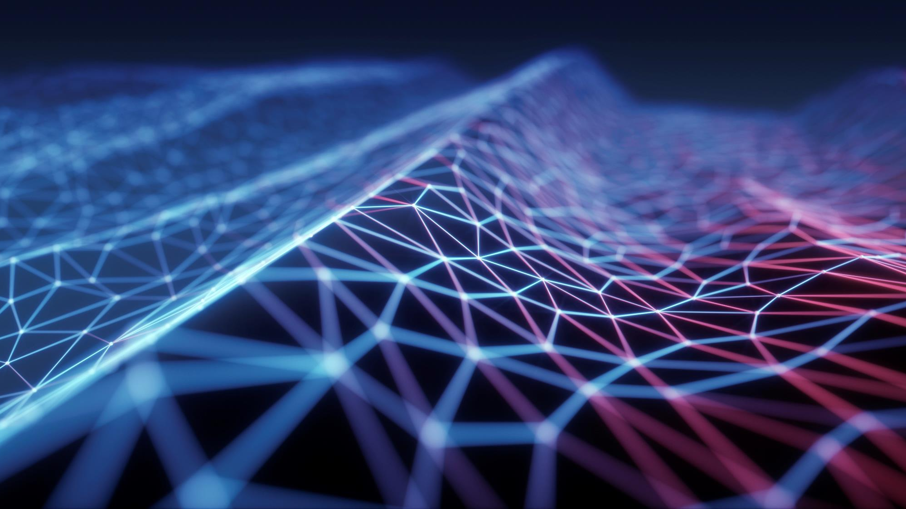
Hand gesture mouse controller
Using MEDIA PIPE , OPENCV AND TENSOR FLOW

Slide 2
CONTENTS
Abstract
Introduction
Overview
Base Paper
Problem Definition
Overall Proposed Architecture
Phase-wise Implementation
Hand gesture output
Conclusion

Slide 3
Abstract
This project presents a real-time mouse control system based on hand gestures using OpenCV and MediaPipe. By detecting and interpreting hand landmarks through a webcam, the system enables users to perform standard mouse actions—such as cursor movement, clicks, and scrolling—without physical contact. It offers a cost-effective, user-friendly alternative to traditional input devices, with potential applications in assistive technology and touch-free interfaces.

Slide 4
Introduction
Traditional input devices like keyboards and mouse, while effective, can be limiting in hands-free or accessibility-focused environments.
Hand gestures provide a natural and intuitive method for controlling computer systems.
This project utilizes OpenCV for image processing and MediaPipe for real-time hand tracking to build a gesture-based mouse control system.
The aim is to develop a cost-effective, efficient, and user-friendly solution that works using just a standard webcam.

Slide 5
OVERVIEW
This project introduces a contactless mouse control system that responds to specific hand gestures
captured via a webcam.
It leverages computer vision and Python libraries to detect and track hand landmarks
in real time.
The system maps gestures (like finger movements and positions) to standard mouse operations such as:
Cursor movement
Left and right clicks
Drag and scroll actions
Technologies used include:
OpenCV for capturing and processing video frames
MediaPipe for robust hand landmark detection

Slide 6
BASE PAPER
Base Paper 1
Title: Hand Gesture Recognition Based on Computer Vision: A Review of Techniques
Authors: Jingdong Yang, Xiaoming Liu, et al.
Published in: IEEE Access, 2020
Summary:
This review paper surveys various computer vision techniques for hand gesture recognition, including skin color segmentation, contour analysis, and motion tracking. It evaluates methods based on accuracy, computational efficiency, and suitability for real-time applications.
BASE PAPER 2
Title: Real-time Hand Tracking with MediaPipe
Authors: Google Research Team
Published by: Google AI Blog, 2020
Summary:
This official work introduces MediaPipe Hands, a framework that detects 21 3D landmarks of a hand in real time using a webcam.
Relevance to Your Project:
Serves as the core technology in your system, offering high-accuracy hand tracking crucial for interpreting gestures and controlling mouse movements.

Slide 7
PROBLEM DEFENITION
Traditional mouse input devices are not suitable for:
Hands-free interaction scenarios
Users with physical disabilities
Environments where touch-based interaction is inconvenient (e.g., public kiosks, medical settings)
Existing gesture-based systems often suffer from:
Low accuracy in gesture recognition
High hardware requirements (e.g., specialized sensors or gloves)
Lag and poor real-time performance
There is a need for a cost-effective, software-based solution that allows accurate and real-time mouse
control using just a standard webcam.

Slide 8
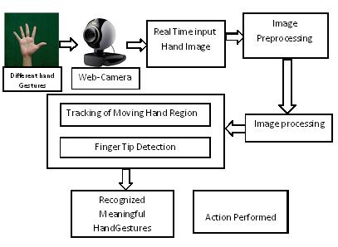
PROPOSED ARCHITECTURE

Slide 9
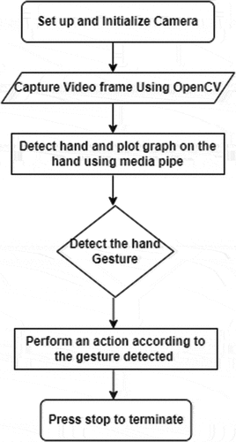
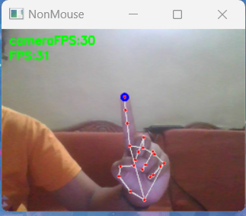
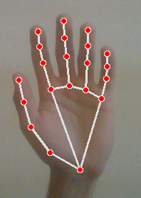
FLOW CHART

Slide 10

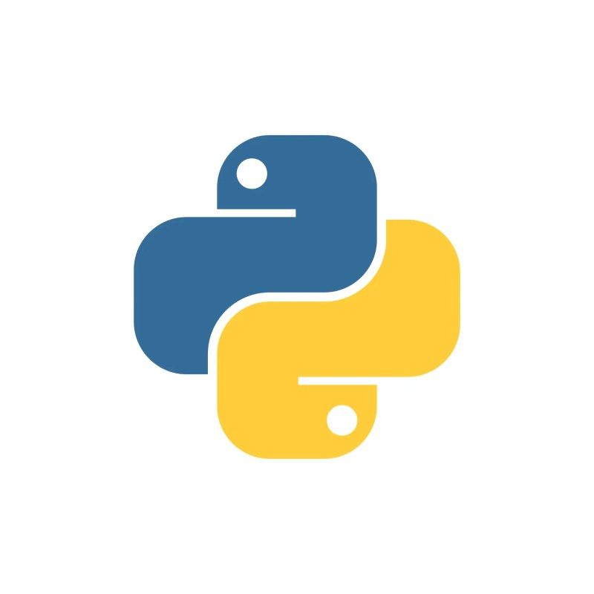
PHASE-WISE IMPLEMENTATION
Phase 1: Environment Setup
Installed necessary tools: Python, OpenCV, and MediaPipe.
Configured the development environment and tested webcam input.
Phase 2: Hand Detection and Tracking
Integrated MediaPipe Hands for detecting 21 hand landmarks.
Verified consistent and real-time tracking of hand movements.
Phase 3: Gesture Mapping
Mapped specific hand gestures to mouse functions such as:
  Cursor movement using index finger
  Clicks based on finger-touch combinations
  Scrolling and double click gestures
Phase 4: Mouse Control Integration
Used Python libraries like pyautogui to convert gestures into actual mouse actions.
Calibrated cursor speed and click sensitivity.

Slide 11
PHASE-WISE IMPLEMENTATION
Phase 5: Optimization and Testing
Fine-tuned gesture detection thresholds for better accuracy.
Conducted multiple tests to reduce lag and improve responsiveness.
Phase 6: User Interface Feedback
Implemented visual indicators (e.g., colored circles) for gesture confirmation.
Improved user experience through intuitive gesture feedback.

Slide 12
GESTURE-BASED MOUSE FUNCTIONS
Cursor Movement:
  Gesture: Move the index finger.
  Function: Moves the mouse cursor based on the movement of the index finger.
  Color: blue color circle in index finger.

Slide 13
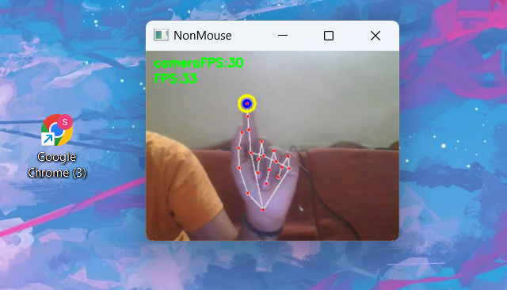
GESTURE-BASED MOUSE FUNCTIONS
Left Click:
  Gesture: Touch the thumb and index finger together.
  Function: Performs a left mouse click.
  color: yellow with blue color circle in index

Slide 14
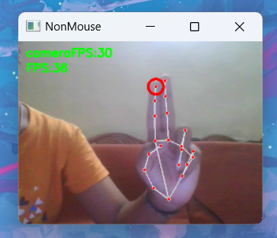
GESTURE-BASED MOUSE FUNCTIONS
Right Click:
  Gesture: Touch the index and middle fingers together.
  Function: Performs a right mouse click.
  color: Red color circle in index

Slide 15
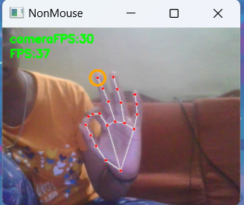
GESTURE-BASED MOUSE FUNCTIONS
Scroll Down:
  Gesture: Raise the last three fingers (middle, ring, and pinky).
  Function: Scrolls the webpage or document down.
  Color indicator : An orange circle appears on the middle finger as a visual indicator.

Slide 16
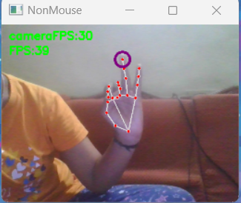
Scroll Up:
  Gesture: Raise the last two fingers (ring and pinky).
  Function: Scrolls the webpage or document up. A purple circle appears on the ring finger as a visual indicator.
  Color: Purple circle in ring finger

Slide 17
CONCLUTION
This project successfully demonstrates a real-time, contactless mouse control system using hand gestures, powered by OpenCV and MediaPipe.
The system is:
Cost-effective, requiring only a standard webcam
User-friendly, with intuitive gesture controls
Accurate and responsive, delivering smooth interaction
All primary mouse functions — including cursor movement, left/right clicks, double clicks, and scrolling — were effectively implemented through distinct gestures.
The results indicate high potential for applications in:
Assistive technologies
Touch-free interfaces
While the current system performs well under controlled lighting,

